Slide 1

The Evolution of Alerting & Lockdown at CWRU
^{CWRU Division of Public Safety}
^{Jeffrey Daberko}
^{Deputy Director}

Slide 2
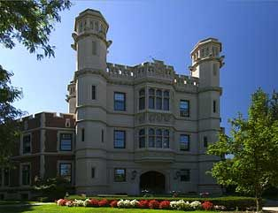
Background- The Institution
Established 1826 in Hudson, OH
1967 merger of Case Institute of Technology & Western Reserve University
Since 1900’s an urban, University Circle based institution.
Fall 2017 enrollment 5125 undergraduate 6595 graduate
Growing international student population
Sworn police department founded in 2006

Slide 3
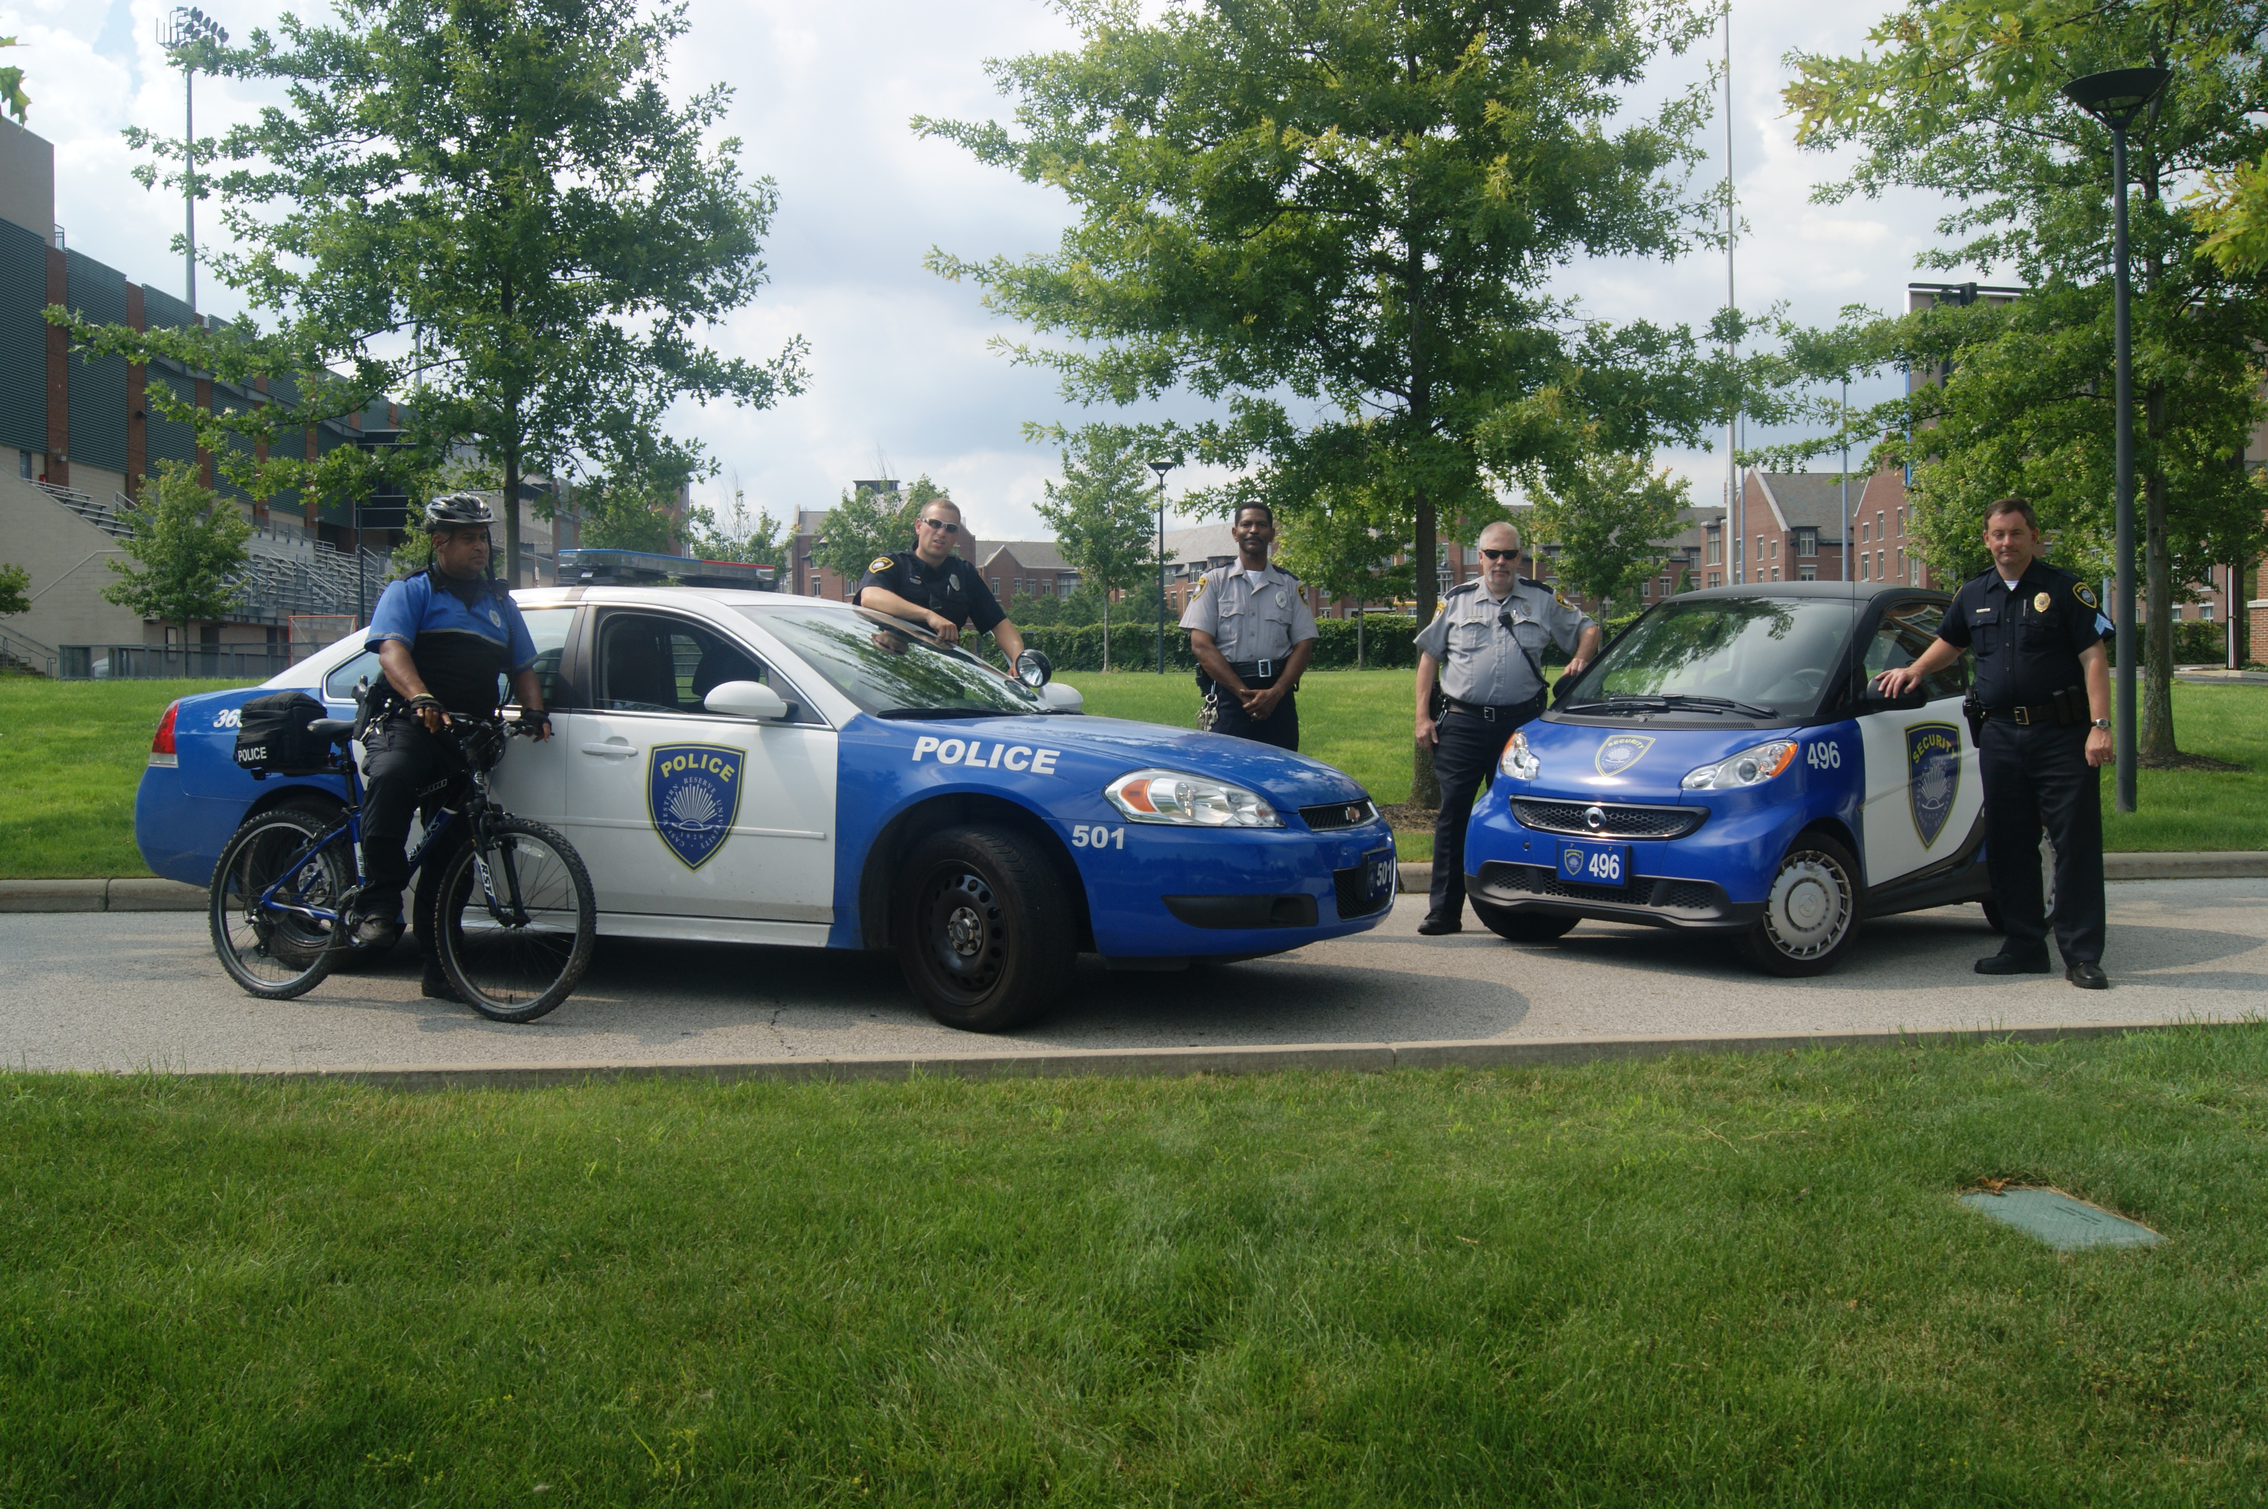
^{CWRU Police & Security Staff}
31 certified police officers
14 mobile security officers
20 building security officers
17 dispatch and support security staff.
We patrol the area in marked patrol vehicles, bicycles and on foot.
CWRU Police officers are commissioned, armed and have arrest powers anywhere in University Circle.
We are a service oriented department that focuses on keeping our community safe through community policing, crime prevention, and emergency response.

Slide 4
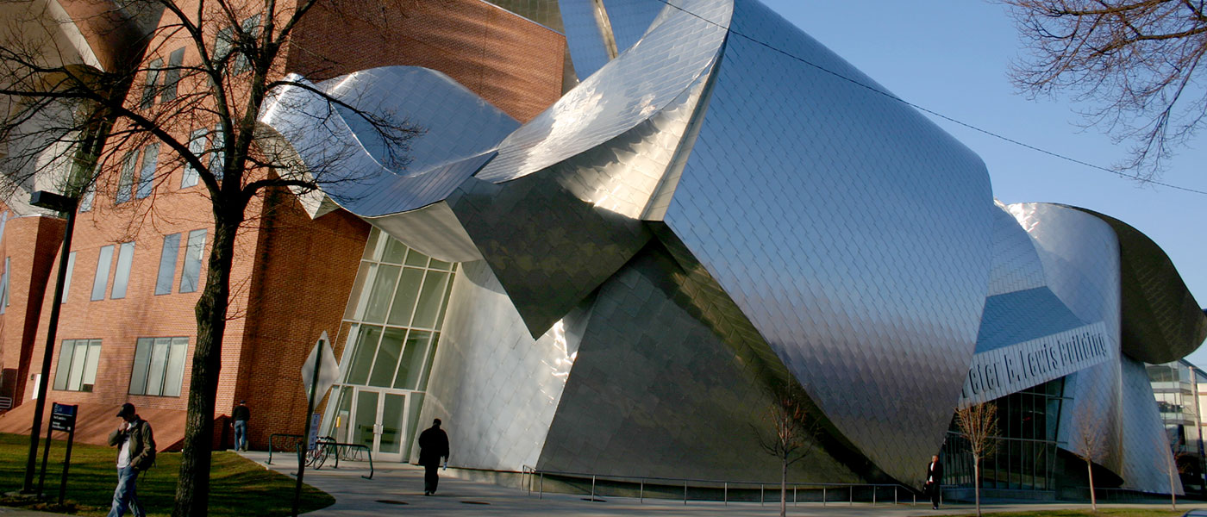
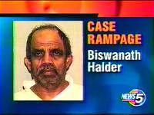
Active Shooter on campus 2003
1 student killed several students/staff injured by active shooter in the Peter B Lewis Building
Peter B Lewis Building

Slide 5
Primary Threats & Safety Programs
ROBBERY – Often occurs on fringe areas of campus , sometimes armed, sometimes not , increasing problem with juveniles.
THEFT- Bicycles, electronics, unattended bags in common areas
OTHER- Panhandlers, Mental Health, alcohol/drug issues
Increasing commercial & residential development in the area- Uptown District 2014, new student center 2015, Maltz Performing Arts Center 2015, Nord Greenway 2018 new Health Education Campus (HEC) 2019. Some redevelopment in surrounding residential neighborhoods. Increasing numbers of students moving off campus who continue to request services

Slide 6
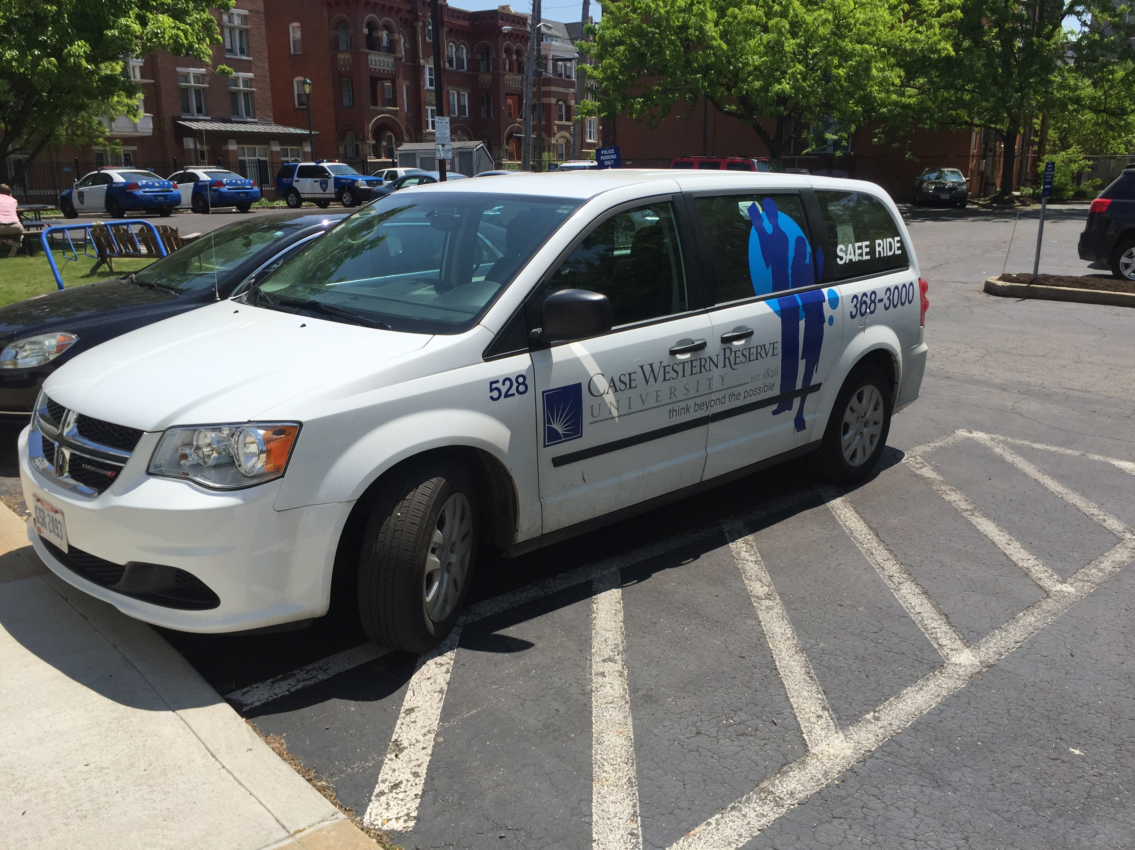
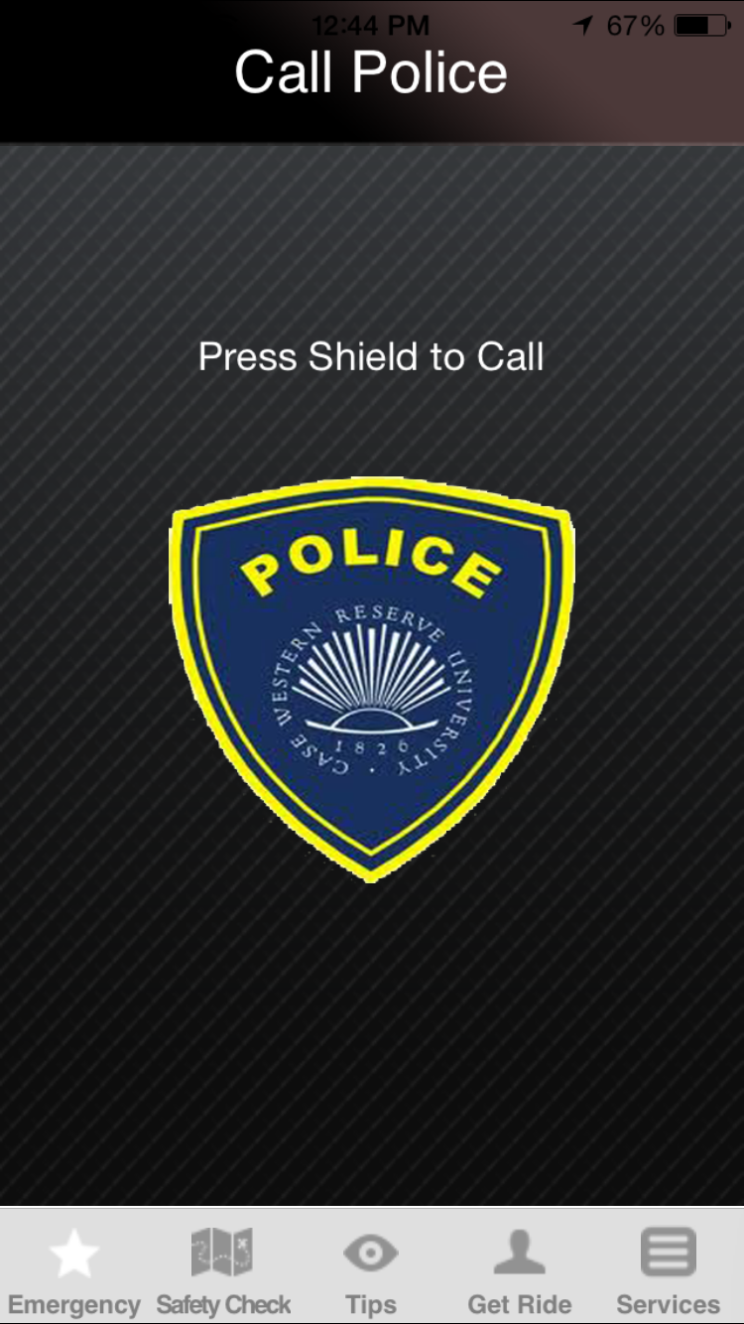
^{CWRU PD Safety Programs}
Mass notification system 2007 (WARN/RAVE)
Safe Ride service 2009 (now 4 vans). Emergency manager 2009.
ALICE Instructors 2013 (RAD program since mid 90’s)
CWRU Shield App 2014
RAVE system used to send out security alerts/timely warnings 2014. Discussions on methodology of alerts.
Series of robberies fall 2016 w/multiple alerts. (Important later!)

Slide 7
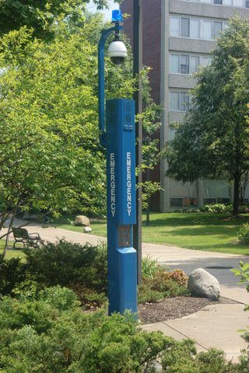
^{Physical Security Systems}
CWRU PD monitors:
1300 access control points / doors
40 blue light phones, 380 elevator/other phones
300 + panic alarms
126 fire alarm systems (also known as bad cooking/marijuana detectors)
750+ CCTV cameras
Emergency outdoor loudspeaker system
RAVE

Slide 8
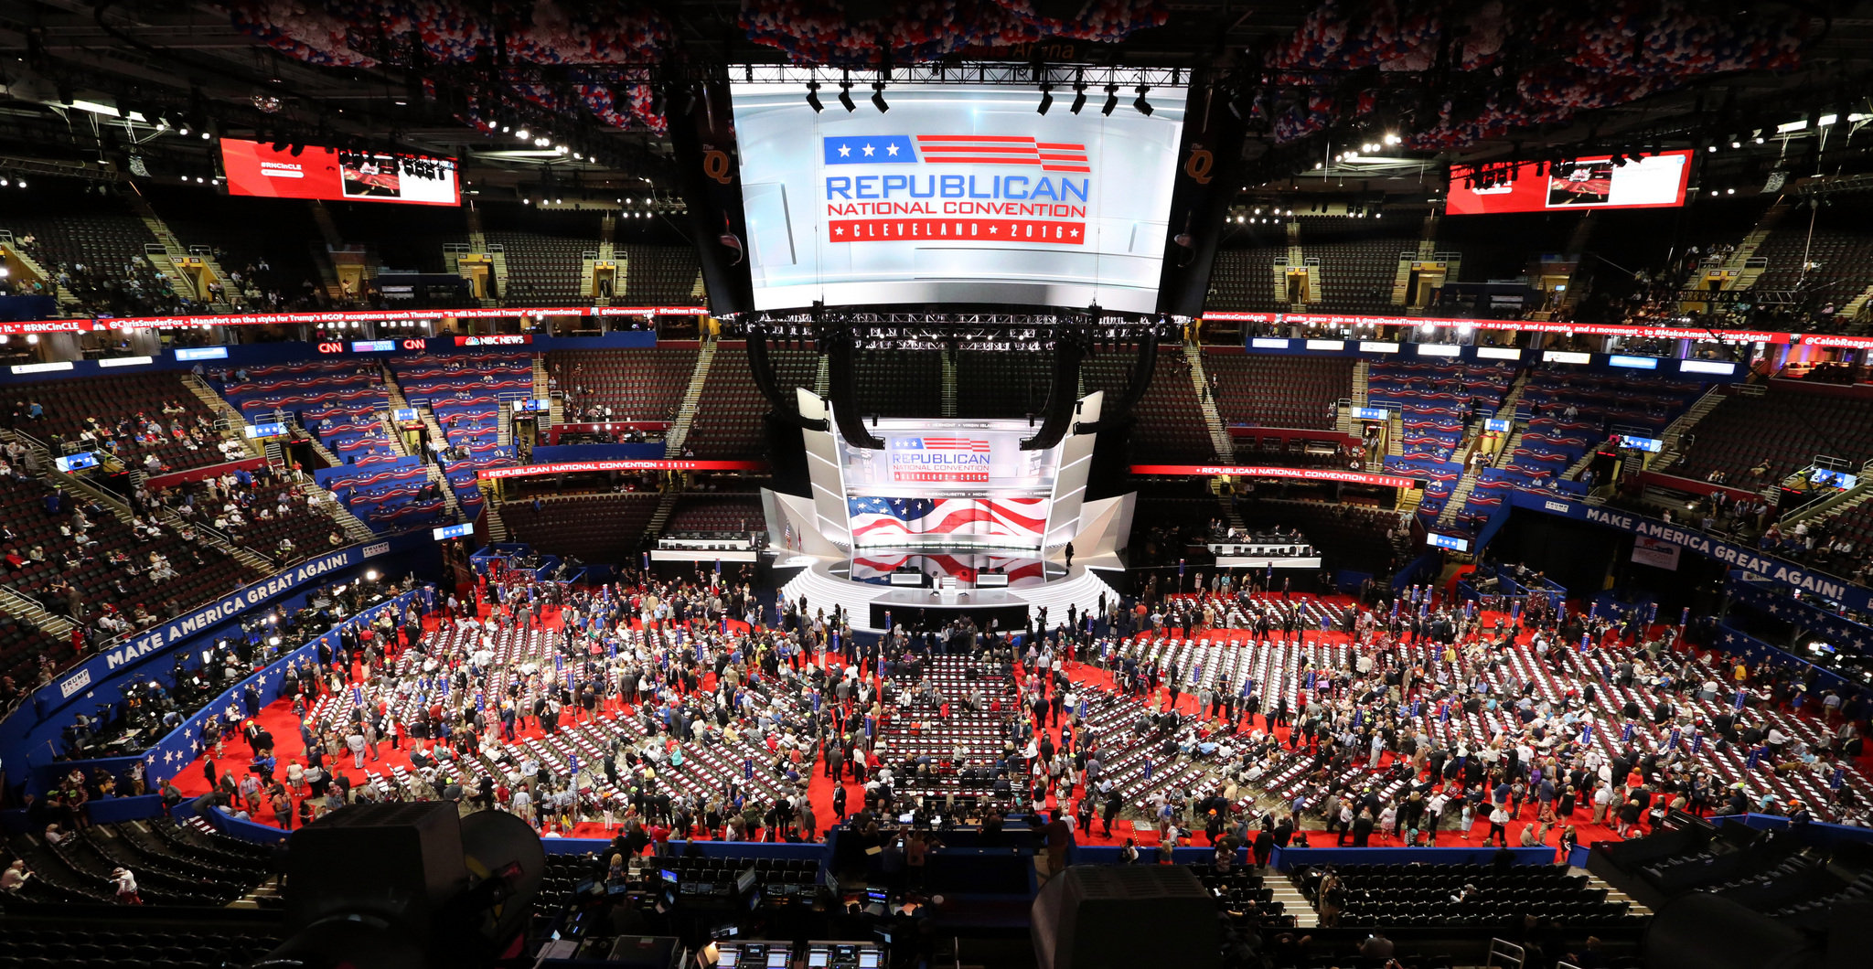
Special Events
Events of Note
Senior Games 2013
Gay Games 2014
Hillary Clinton rally on campus 2015
Republican National Convention 2016
1,900 LE officers staying on campus for RNC security

Slide 9

4/16/17 Easter Sunday
On Easter Sunday 4/16/17 Robert Goodwin Sr was shot to death by a male who later posted a video of the shooting on Facebook.
Shooting took place at 1400 hours in the Glenville area

