Slide 1
25Live-Lenel Integration
Courtesy of James Dornan

Slide 2
Gleam in the Registrar’s eye
We talked about it for years!
Manual coordination between building managers with classrooms and registrar was (ahem) difficult in many situations
Identifying funding was a major stumbling block

Slide 3
Go forth and develop!
They found the money!
We had two options
Lenel
Roll our own
Decision: roll our own!
Why not lenel?
Expense (note: it cost as much for us to do)
Couldn’t share solution with others, develop as a group

Slide 4
Magic happens here
Spent several weeks working with client to define requirements
Run just off hours or 24 hours?
How long to open before/after classes
James made magic
Rolled out to 2 buildings, then 4
Full rollout by end of July

Slide 5
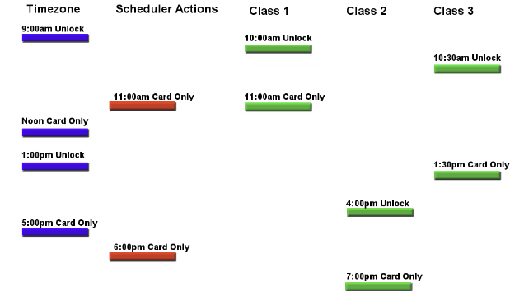
Building Reader Timeline

Slide 6
gotchas
25live
Space id’s
Reservations vs events
How they store data!
Lenel
Timezone collisions
Scheduler
Door states – unlocked, card only, locked

Slide 7
Questions?

