Slide 1

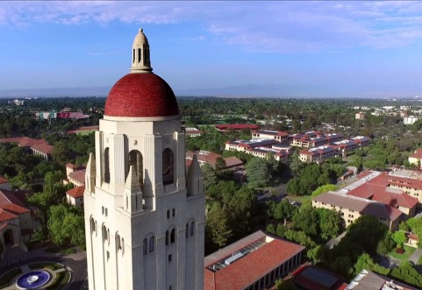
Access Control | The Business Side
Presentation to HELUG 2017
Ted Reavis, Wake Forest University
Jay Kohn, Stanford University

Slide 2

IT’S AN ACCESS CONTROL SYSTEM!
You’ve run the gauntlet, navigated the maze,
received initial funding, and installed the system.
Now what?

Slide 3
IT’S AN ACCESS CONTROL SYSTEM!
How do you manage/fund system maintenance?
How do you manage/fund refresh? growth? migration?

Slide 4
THE BUSINESS SIDE AT STANFORD
Make it sustainable

Slide 5
THE BUSINESS SIDE AT STANFORD
DAILY OPERATIONS
FUTURES
Staffing
Software, hardware
Repairs and maintenance
Incremental growth, new installations, SYSTEM REFRESH
Establish a business model to support ongoing operations, including futures

Slide 6





DAILY OPERATIONS
System and application administration
Installation and Maintenance
Networking Systems
IT Operations Center (24x7)
Building Managers
Lock Shop
Our primary staff are the application administrators
(3 admins and 1 developer)
We pay for portions of staff from other groups
for daily support
Lock Shop has some central funding;
some we fund
Building Managers take care of local access

Slide 7
DAILY OPERATIONS
System and application administration
Installation and Maintenance
Networking Systems
IT Operations Center (24x7)
Building Managers
Lock Shop
All funded by reader rate
$29/reader/month
Our primary staff are the application administrators
(3 admins and 1 developer)
We pay for portions of staff from other groups
for daily support
Lock Shop has some central funding;
some we fund
Building Managers take care of local access

Slide 8
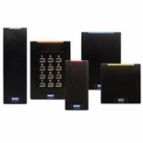


FUTURES
I need another reader
New buildings and projects
This stuff gets old…
Moved from rate model to time and materials for installations – full cost recovery
New buildings include access control in the project costs, then the department pays maintenance
Many people run the equipment until it fails!
Even if you wait for it to fail, you need a revenue stream to cover costs

Slide 9

ALTERNATIVES
OPTION 1
Run until it fails
Go under the wall
Need funding for replacements
What if a LOT fails?

Slide 10
ALTERNATIVES
OPTION 2
Fund as needed
Go over the wall
Apply for central funds on project basis
Apply for central funds as needed

Slide 11
ALTERNATIVES
OPTION 3
Have a plan
Go through the wall
Determine the life of the equipment
Determine the cost of replacement
Establish funding source through rates or central funds

Slide 12
Notes:
BLE removes the need to pair devices

Slide 13

HAVE A PLAN!
Worked with VAR to identify reasonable life of equipment
Worked with Finance to identify funding alternatives
Developed a model that would reflect funding for daily operations as well as refresh
Notes:
BLE removes the need to pair devices

Slide 14
BUILDING A PLAN FOR GETTING FROM DAILY TO FUTURE DETERMINING FACTORS
DAILY OPERATIONS
Need to fund people (system and application administrators, developer, support staff
FUTURES
Need to fund break/fix repairs and maintenance
Track cost of people, software, hardware
Develop a model to cover all current and projected costs

Slide 15
BUILDING A PLAN FOR GETTING FROM DAILY TO FUTURE
MODEL
EQUIPMENT LIFE
FORMULA
RESEARCH
DAILY OPERATIONS
Need to fund system administrators and application administrators (and manager)
FUTURES
OPTIONS:
10 years – conservative
12 years – realistic
15 years – taking chances
Determine weighting of parts
Various equipment life lengths
Growth, use
Operational environment
Interruption to essential ops
Reach out to peers for
reviews/recommendations on devices, maintenance, etc.
HELUG listserve
Need to fund field support from technicians, networking, and 24 hour staff
Track cost of people, software, hardware
Develop a model to cover all current and projected costs

Slide 16
FORMULA
Building Access Liability Forecast
 | Current Qty (Used to Determine Weight) | Weight | Unit Cost (example, not actual) | Cost per Door
Wired:
LNL-8000 | 350 | 0.14 | 500 | 70
LNL-3300 | 350 | 0.14 | 2,000 | 280
LNL-2220/LNL-2210 | 15 | 0.01 | 1,500 | 9
LNL-1100 | 350 | 0.14 | 600 | 84
LNL-1200 | 450 | 0.18 | 600 | 108
LNL-1320 | 40 | 0.02 | 500 | 8
LNL-1300 | 2500 | 1.00 | 150 | 150
Reader | 2500 | 1.00 | 350 | 350
DS160 (REX) | 150 | 0.06 | 75 | 5
Labor (incl activation & proj mgmt) | n/a | 1.00 | 1,500 | 1,500
Avg Cost Wired |  |  |  | 2,494
 |  |  |  | $2500
Wireless:
WAP - ILS | 140 | 0.51 | 500 | 257
WAP - Schlage | 2 | 0.50
Reader - Wireless ILS | 272 | 1.00 | 1,000 | 1,000
Reader - Wireless Schlage (incl mobile) | 4 | 0.01 | 1,000 | 15
Labor (incl activation & proj mgmt) | n/a | 1.00 | 950 | 950
Avg Cost Wireless |  |  |  | 2,222
 |  |  |  | $2200
Offline Locks:
Mortise Reader | 0 | - | 600 | -
Cylindrical Reader | 29 | 1.00 | 500 | 500
Labor (incl activation & proj mgmt) | n/a | 1.00 | 400 | 400
Avg Offline Lock |  |  |  | 900
Volumes | YEAR 1 | YEAR 2 | YEAR 3
Number of Lenel Doors Installed (Wired) | 100 | 350 | 200
Total Number of Lenel Doors (Wired) | 100 | 450 | 650
Number of Lenel Doors Installed (Wireless) |  | 25 | 150
Total Number of Lenel Doors (Wireless) |  | 25 | 175
Number of Lenel Doors Installed (Offline) |  |  | 10
Total Number of Lenel Doors (Offline) |  |  | 10
Total Number of Refresh Doors | 100 | 475 | 835
Cost rise on hardware | 1%
Cost rise on labor | 3%
Years of Life | 12

Slide 17
TOTAL LIABILITY
LIABILITY | YEAR 1/11 | YEAR 12 | YEAR 13 | YEAR 14 | YEAR 15 | YEAR 16 | YEAR 17
Wired |  | 25,000 | 875,000 | 50,000 | -- | -- | --
Wireless |  |  | 55,000 | 330,000 | -- | -- | --
Offline |  |  |  |  |  |  | --
TOTAL |  | 25,000 | 930,000 | 380,000 | -- | -- | --
Funding Requirement
How much you will need each year going forward?
Actual/year? Bundled $1,335
Smoothed(25+930+380)/3=$445

Slide 18
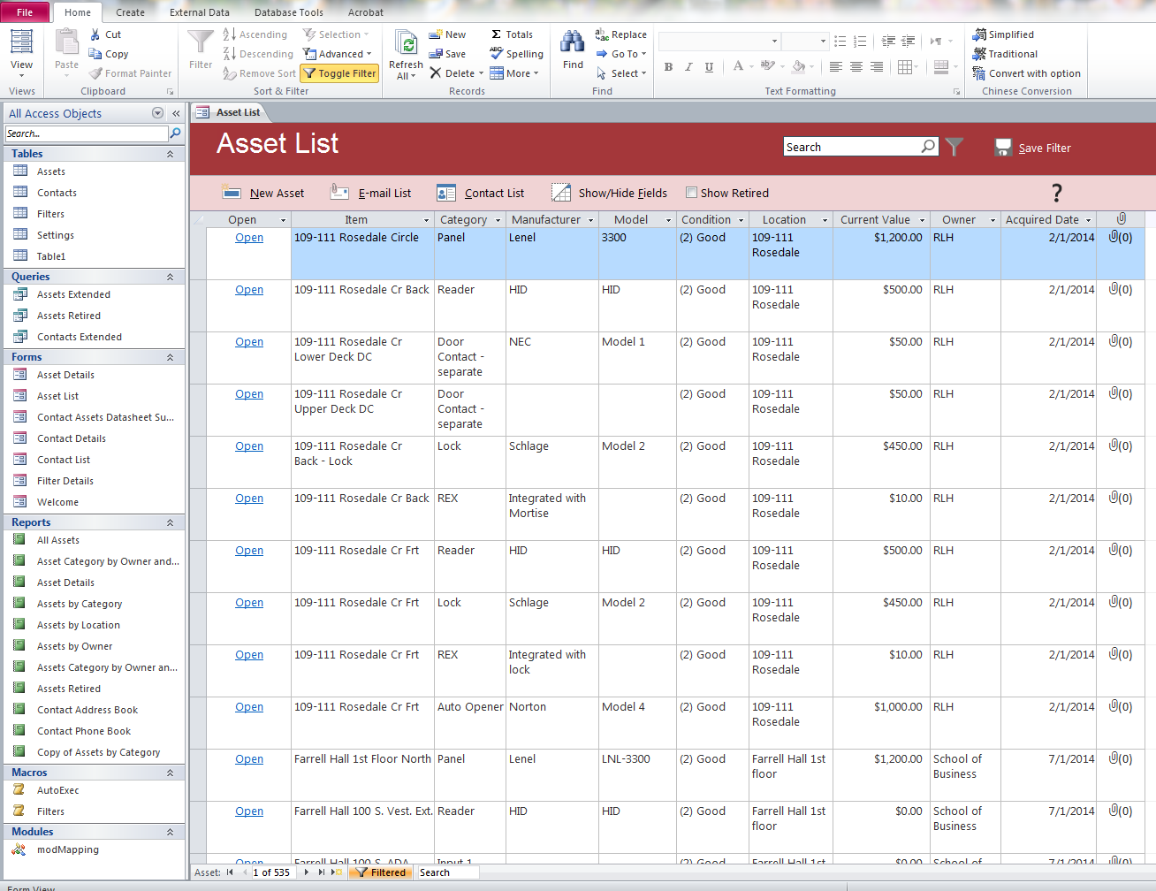
ASSET AGE AND COST TRACKING
Notes:
BLE removes the need to pair devices

Slide 19
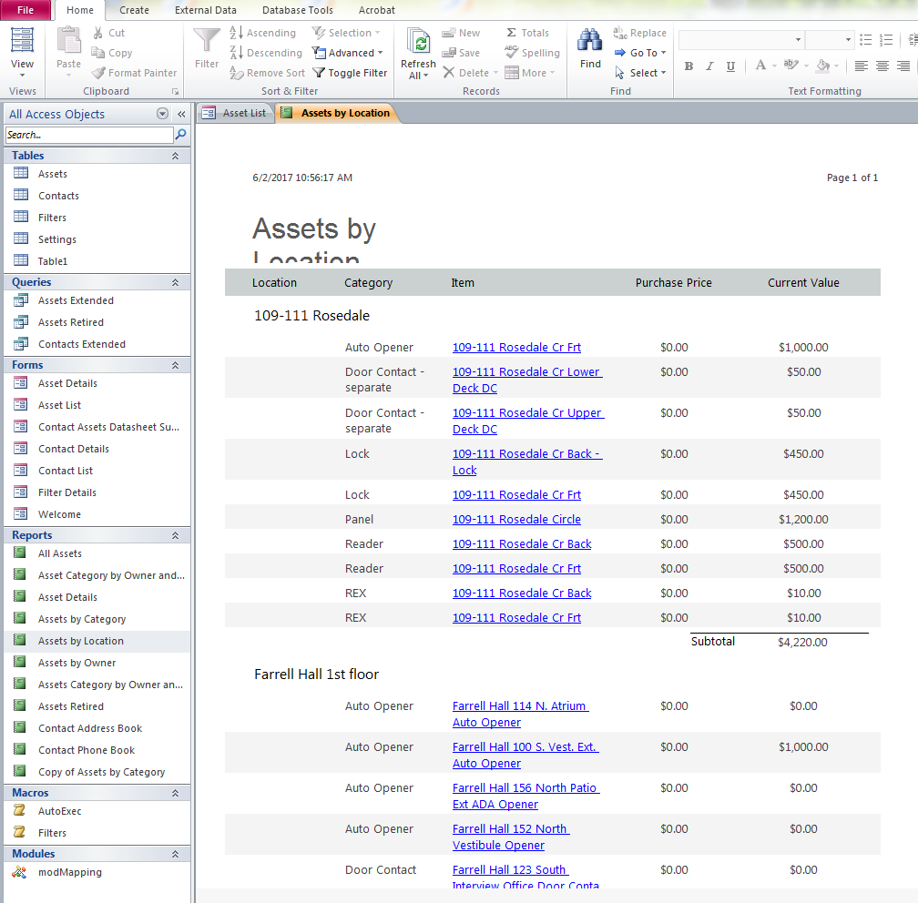
ASSET LOCATION AND COST REPORTING
Notes:
BLE removes the need to pair devices

Slide 20


QUESTIONS AND DISCUSSION
Ted Reavis
Physical Security Technology Administrator and Project Manager
reavistw@wfu.edu
Jay Kohn
Director of Card Services
jkohn@stanford.edu

